Slide 1

A Graph Convolutional Neural Network (GCNN) Modelling for Hub-Gene identification in Alzheimer’s Disease Using Integrated Co-expression and Protein-Protein Interaction(PPI) analysis with Cross-Dataset Validation.
Presented by
FALGUNI YADAV (UG/02/BTCSE/2022/012)
RUCHI SINGH (UG/02/BTCSE/2022/054)
CHAITI BAIN (UG/02/BTCSE/2022/055)
Under the supervision of
Mr. Arup Mallick
Assistant Professor
Department of Computer Science and Engineering
Adamas University

Slide 2
PROBLEM STATEMENT
Alzheimer's Disease (AD) is a progressive neurodegenerative disorder causing memory loss, cognitive decline, and eventual death, with cases rapidly increasing worldwide.
Early diagnosis is vital to slow progression, but traditional methods detect AD at advanced stages
Difficulty in identifying reliable hub genes in Alzheimer's disease (AD)
Limitations in modeling co-expression and Protein-Protein Interaction (PPI)networks
Advanced models like GCNN (Graph Convolutional Neural Network )for better analysis.

Slide 3
OBJECTIVES
Analyze gene expression data from GEO datasets : GSE48350 (AD vs Control) , GSE11882 (AD vs Control)
Identify Differentially Expressed Genes (DEGs)
Apply GCNN to learn complex relationships
Construct gene interaction networks (co-expression + PPI)
Identify key hub genes related to Alzheimer’s disease

Slide 4
RESEARCH GAP
LIMITED CROSS-DATASET REPRODUCIBILITY
most existing ad gene identification studies rely on single-cohort analysis and lack validation across independent datasets, reducing reliability.
INADEQUATE MODELING OF COMPLEX GENE NETWORKS
traditional statistical and differential expression methods fail to capture nonlinear and higher-order interactions within biological networks.
POOR INTEGRATION OF MULTI-SOURCE BIOLOGICAL DATA
many approaches do not effectively combine gene expression data with protein–protein interaction (ppi) networks and prior biological knowledge.
LACK OF INTERPRETABILITY IN DEEP LEARNING MODELS
existing deep learning models often act as black boxes, providing limited insight into gene-level contributions and biological mechanisms.
INSUFFICIENT TRANSLATION TO THERAPEUTIC TARGET DISCOVERY
few computational pipelines systematically connect predicted disease genes to experimentally testable therapeutic hypotheses.

Slide 5
LITERATURE REVIEW
Ref. | Paper Name | Method | Contribution | Research Gap
Zhang & Kiryu, 2023 (Scientific Reports) | Identification of oxidative stress-related genes differentially expressed in Alzheimer’s disease and construction of a hub gene-based diagnostic model | DEG analysis (Limma), WGCNA, PPI network (STRING), ROC analysis, LASSO regression | Identified 5 oxidative stress-related hub genes (MAPK9, FOXO1, BCL2, ETS1, SP1) and developed a 5-gene diagnostic model (AUC = 0.88 validation) | Lack of experimentally validated oxidative stress biomarkers; need clinical validation;
Cheng et al., 2021 (American Journal of Alzheimer’s Disease & Other Dementias®) | Identification of Hub Genes Related to Alzheimer’s Disease and Major Depressive Disorder | GEO dataset analysis, DEG screening (Limma), TF–gene & miRNA–gene networks; ROC analysis | Identified 79 shared DEGs between AD and MDD, Validated gene expression after venlafaxine treatment | Lack of brain tissue datasets for MDD; Small validation sample size; No experimental (in vivo/in vitro) validation

Slide 6
LITERATURE REVIEW
Ref. | Paper Name | Method | Contribution | Research Gap
Zhao et al., 2022 (Frontiers in Aging Neuroscience) | Integrated analysis and identification of hub genes as novel biomarkers for Alzheimer’s disease | GEO dataset analysis, DEG screening (Limma); Immune-related gene intersection. | Identified 153 immune-related DEGs; Discovered 5 hub genes , Identified AGAP3 as key diagnostic biomarker | Lack of experimental validation, Limited clinical data in GEO datasets; Small sample diversity; Mechanistic role of AGAP3 in AD progression not fully explored
Abd ul Kader et al., 2024 (Journal of Kufa for Mathematics and Computer) | Abd ul Kader et al., 2024 (Journal of Kufa for Mathematics and Computer) | Constructed weighted Protein–Protein Interaction (PPI) network (HPRD + GWAS), HITS algorithm | Proposed improved HITS-based weighted PPI approach; Identified top 10 AD hub genes , Integrated biological data with network topology | No experimental (wet-lab) validation of identified genes; Limited to PPI and GWAS datasets; Clinical applicability not validated.

Slide 7
PROCESS PIPELINE
Data Collection GSE48350 + GSE11882 ↓ Preprocessing (Clean data, probe → gene, common genes) ↓ Normalization (Min-Max scaling: 0–1) ↓ Feature Engineering (Mean + Variance) ↓ Graph Construction (Nodes: Genes | Edges: Co-expression, PP) ↓
GCNN Training (Features + Network) ↓ Validation (Train → Test on another dataset) ↓ Hub Genes (Top-ranked genes) ↓ Final Output Alzheimer's disease genes identified

Slide 8
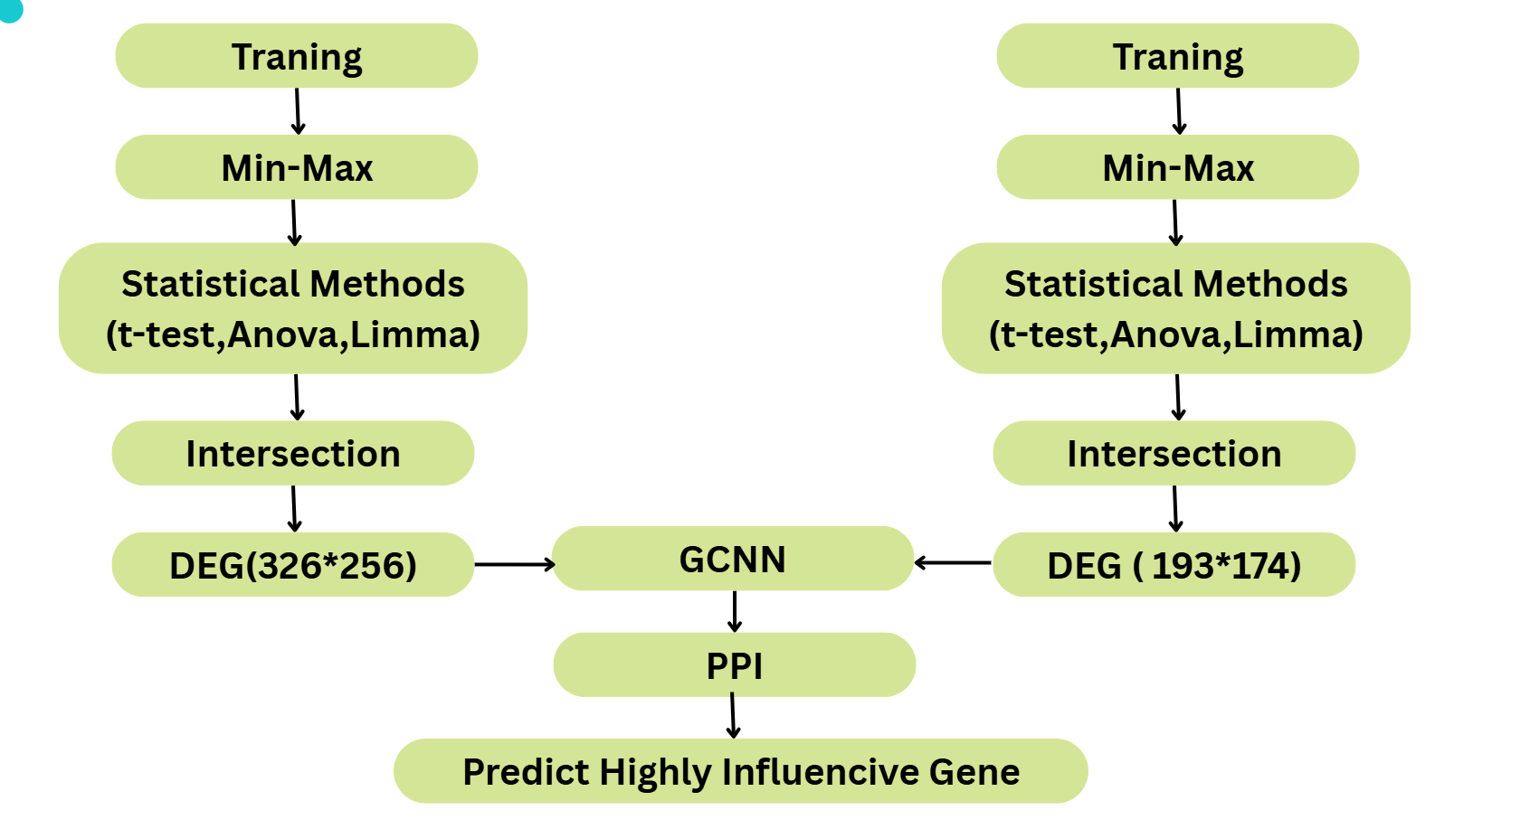
WORKFLOW

Slide 9
MODEL DETAILS
Model: Graph Convolutional Neural Network (GCNN)
Input: GSE48350 & GSE11882 + PPI network
Graph: Nodes (genes), Edges (co-expression + PPI)
Features:
Expression (disease vs control)
Variance
Training:
Semi-supervised (known AD genes as seeds)
Optimizer: Adam | Loss: Binary Cross-Entropy
Validation:
Cross-dataset (train on one, test on another)
Output:
Gene importance scores
Top hub genes (Top 20 selected after GCNN)

Slide 10
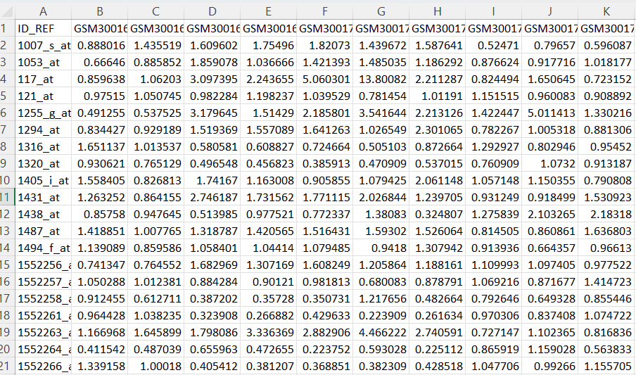
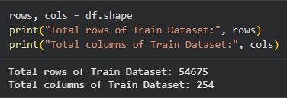
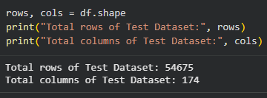
DATASET COLLECTION
Datasets obtained from National Center for Biotechnology Information (NCBI)
Website: https://www.ncbi.nlm.nih.gov
Accessed through Gene Expression Omnibus (GEO)
Website: https://www.ncbi.nlm.nih.gov/geo/
Selected datasets:
GSE48350
GSE11882
Microarray-based gene expression data
Includes Alzheimer’s disease and control samples
Expression matrices downloaded for preprocessing

Slide 11
DATA PREPROCESSING
Data Collection: GSE48350 & GSE11882 (GEO)
Data Cleaning: Removed missing values & duplicates
Probe Mapping: Probe IDs → gene symbols
Normalization: Min–Max scaling (0–1)
Statistical Analysis:
Applied limma, t-test, and ANOVA
Computed p-values for each gene
Selected significant genes (p < 0.05)
Removed non-significant genes
6. Result Integration:
Performed analysis on both datasets
Intersected significant genes
Obtained common gene set
7. Feature Extraction: Mean expression & variance
8. Graph Construction: Nodes = genes, Edges = co-expression / PPI

Slide 12
MODEL PERFORMANCE
Epoch | Loss | AUC | PR-AUC | Accuracy | F1- Score | Precision | Recall | Sensitivity | Specificity
50 | 0.3555 | 0.9717 | 0.9654 | 0.9010 | 0.8959 | 0.9545 | 0.844 | 0.844 | 0.9597
100 | 0.1865 | 0.9798 | 0.978 | 0.9166 | 0.9196 | 0.8874 | 0.9542 | 0.9542 | 0.879
150 | 0.2442 | 0.9739 | 0.9741 | 0.9081 | 0.9067 | 0.9211 | 0.8927 | 0.8927 | 0.9235
200 | 0.2004 | 0.9787 | 0.9784 | 0.9171 | 0.9195 | 0.8939 | 0.9466 | 0.9466 | 0.8877
250 | 0.1902 | 0.9803 | 0.9781 | 0.9191 | 0.9227 | 0.8836 | 0.9654 | 0.9654 | 0.8729
300 | 0.2604 | 0.9804 | 0.9799 | 0.9184 | 0.9174 | 0.9289 | 0.9062 | 0.9062 | 0.9306
High accuracy (~90–92%) with strong AUC/PR-AUC (~0.97–0.98) indicates robust performance
Balanced Precision, Recall, and F1 Score ensure reliable classification
Best performance observed around Epoch 200–250

Slide 13
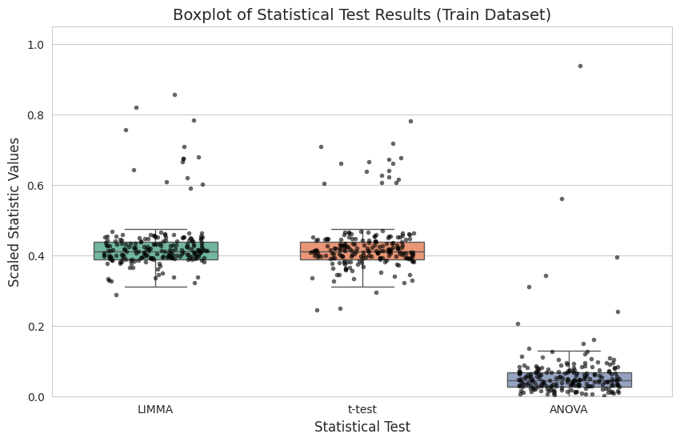
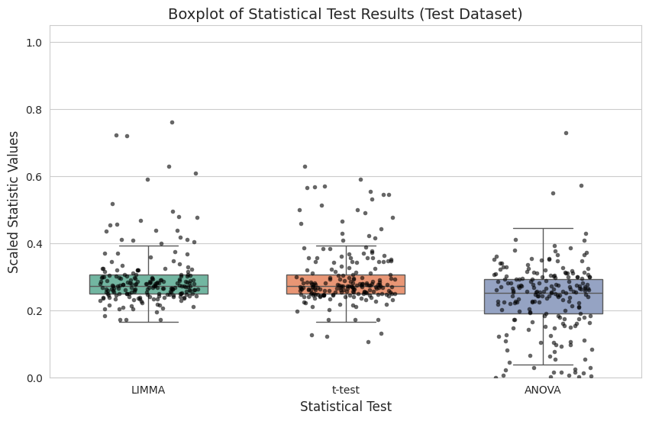
RESULTS AND DISCUSSION
Boxplot of Statistical Test Results (Train Dataset)
Boxplot of Statistical Test Results (Test Dataset)
Data collected and preprocessed (i.e., normalization, cleaning)
DEGs identified and used for feature selection
Dataset prepared:
Train: 326 × 256
Test: 193 × 174
Box plot used to compare statistical methods (LIMMA, t-test, ANOVA) and analyze variation
Data found well-scaled and suitable for advanced modeling (i.e., GCNN)

Slide 14
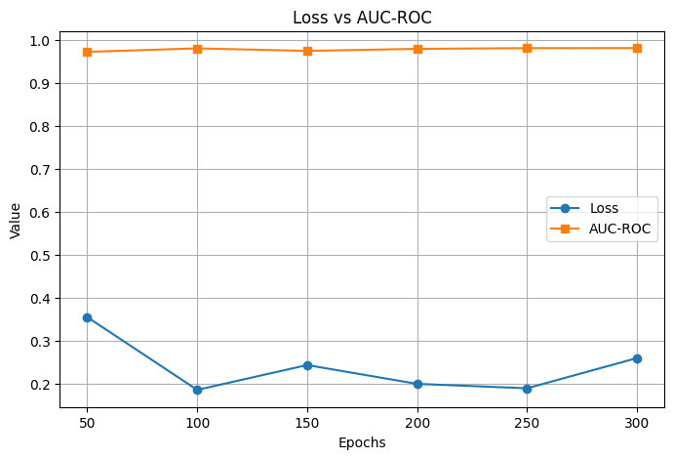
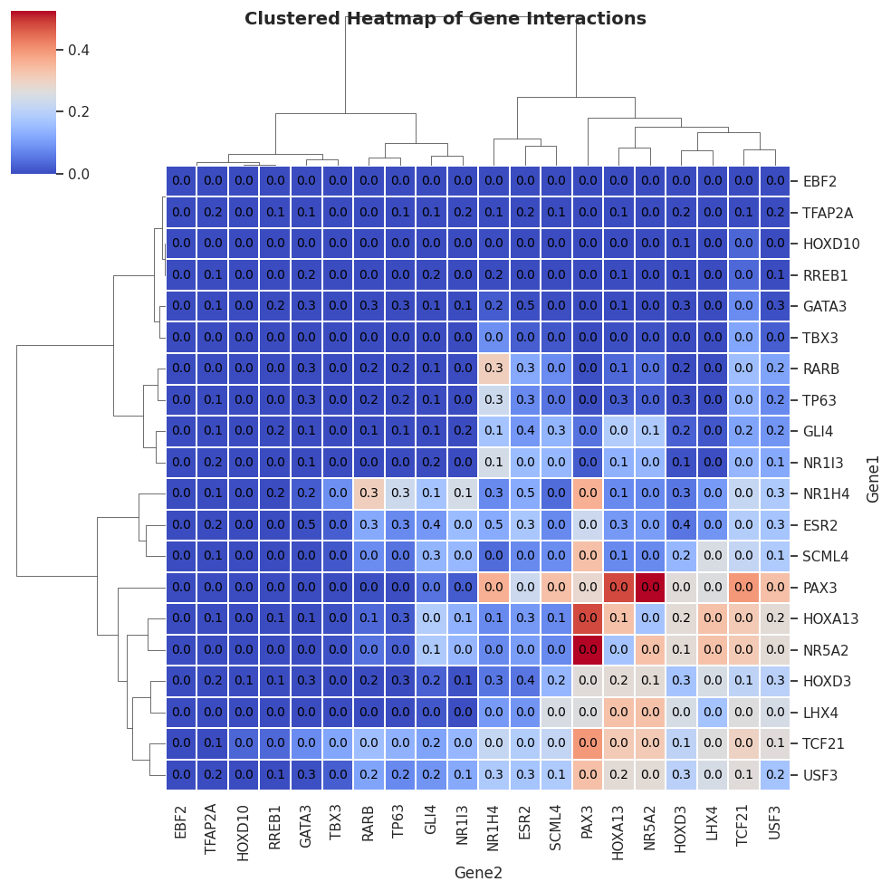
RESULTS AND DISCUSSION
Loss vs AUC-ROC Plot
Loss decreases initially, indicating effective learning
Minor fluctuations suggest stable training process
AUC-ROC remains consistently high (~0.97–0.98)
High AUC indicates strong classification performance
Model shows good convergence and reliability
Clustered Heatmap of Gene Interactions
Displays interaction strength between top genes
Clustering groups genes with similar interaction patterns
Higher values (red) indicate strong gene associations
Lower values (blue) indicate weak interactions
Helps identify potential hub genes and functional modules

Slide 15
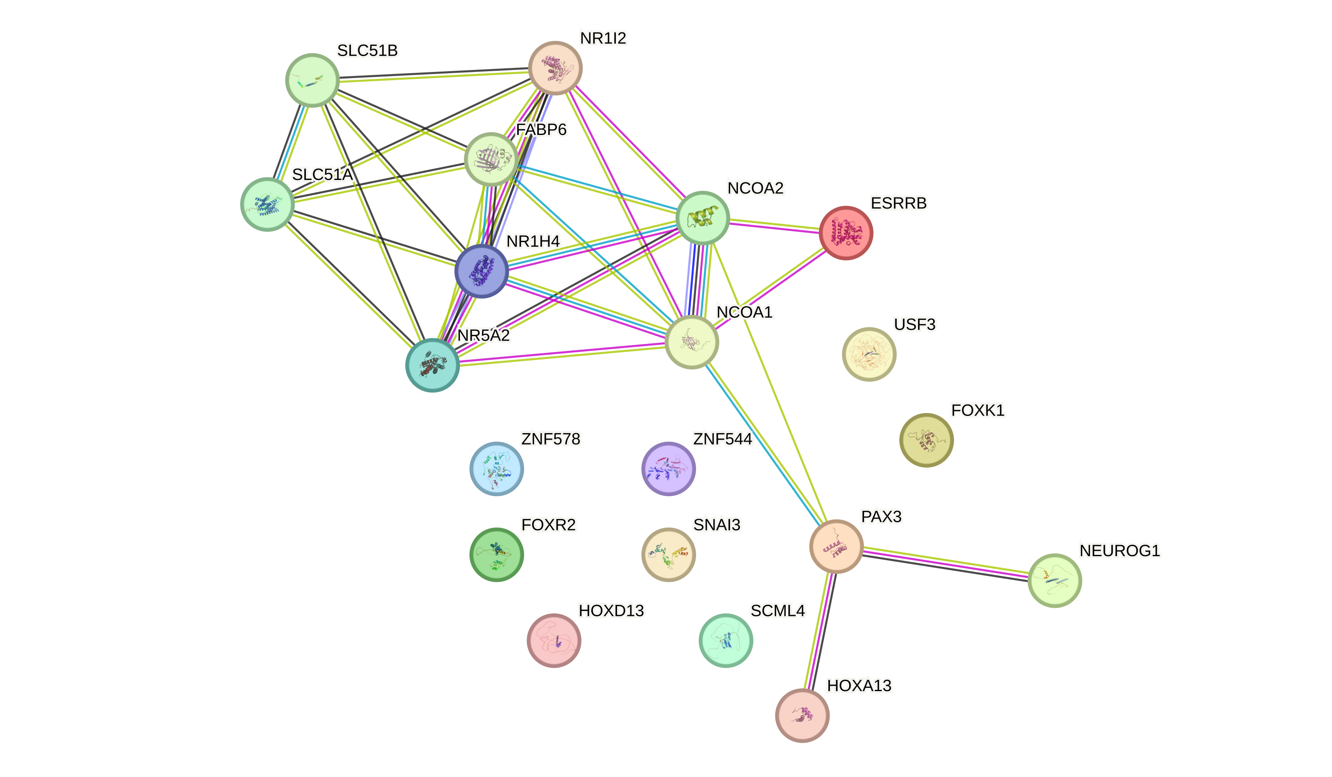
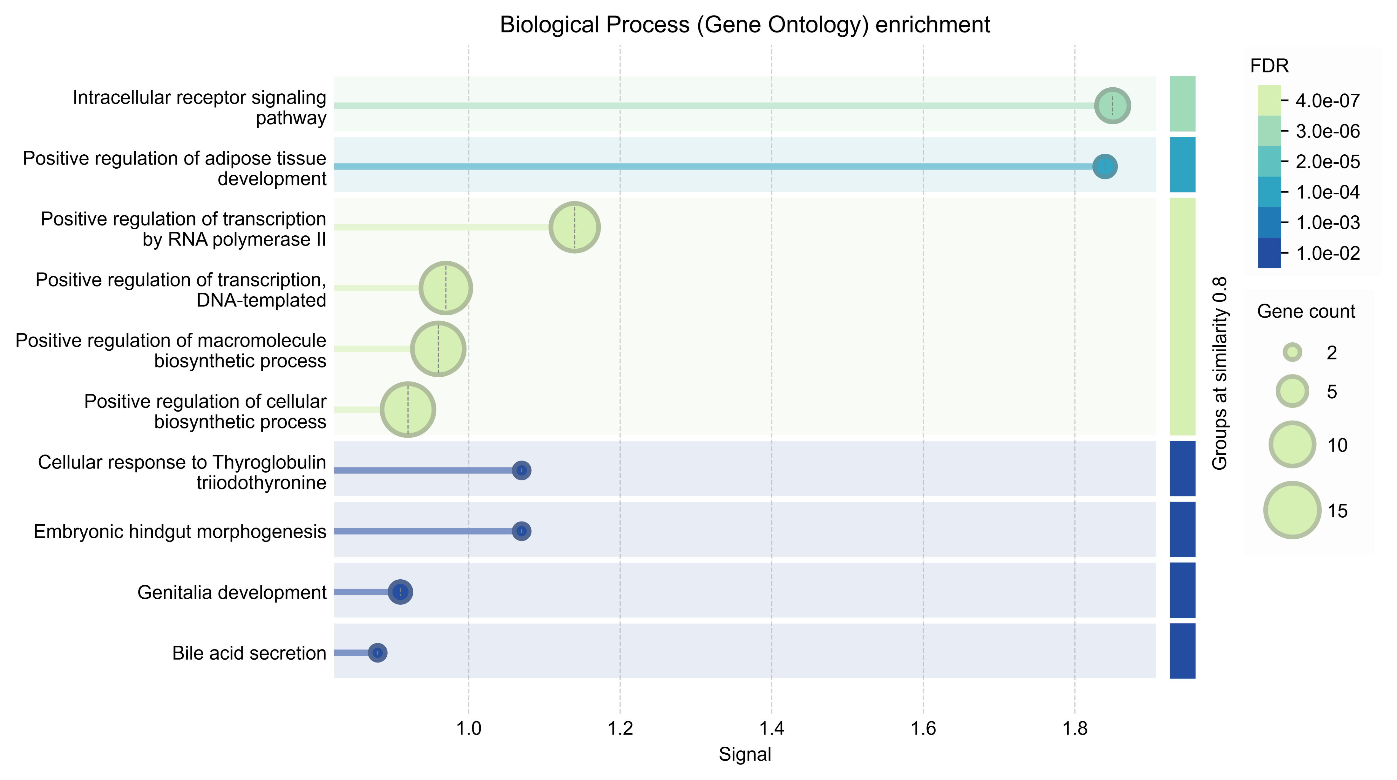
RESULTS AND DISCUSSION
Gene–Gene Interaction Network
Visualizes interactions between selected genes
Nodes represent genes; edges represent interactions
Highly connected nodes indicate potential hub genes
Dense clusters show strong functional relationships
Useful for understanding complex biological pathways
Functional Enrichment Analysis (Bubble Plot)
Shows enriched biological pathways of selected genes
Bubble size represents number of genes involved
Color scale (FDR) indicates statistical significance
Larger and lighter bubbles = highly significant pathways
Helps identify key biological processes linked to disease

Slide 16
CONCLUSION
GCNN framework successfully identified robust and biologically meaningful Alzheimer’s disease hub genes
Model demonstrated strong generalization across multiple datasets without retraining
Attribution analysis improved interpretability by highlighting gene contributions
Identified hub genes are significantly enriched in key AD-related pathways
Results support biological relevance of synaptic, inflammatory, and mitochondrial processes
Findings highlight potential targets for future therapeutic research

Slide 17
REFERENCES
[1]Al-Shoukry, S., Rassem, T. H., & Makbol, N. M. (2020). Alzheimer’s diseases detection by using deep learning algorithms: a mini-review. IEEE Access, 8, 77131–77141. https://doi.org/10.1109/ACCESS.2020.298939
[2] Arya, A. D., Singh Verma, S., Chakrabarti, P., Chakrabarti, T., Elngar, A. A., Nami, M., et al. (2023). A systematic review on machine learning and deep learning techniques in the effective diagnosis of Alzheimer’s disease. Brain Informatics, 10(17). https://doi.org/10.21203/RS.3.RS-2028945
[3] El-Gawady, A., Makhlouf, M. A., Tawfik, B. S., & Nassar, H. (2022). Machine Learning Framework for the Prediction of Alzheimer’s Disease Using Gene Expression Data Based on Efficient Gene Selection. Symmetry, 14(3), 491. https://doi.org/10.3390/sym14030491
[4] Mahendran, N., Vincent, P. M. D. R., Srinivasan, K., & Chang, C.-Y. (2021). Improving the Classification of Alzheimer’s Disease Using Hybrid Gene Selection Pipeline and Deep Learning. Frontiers in Genetics, 12, 784814. https://doi.org/10.3389/fgene.2021.784814
[5] Ray, S., et al. (2017). A comprehensive analysis on preservation patterns of gene co-expression networks during Alzheimer’s disease progression. BMC Bioinformatics, 18, 579. https://doi.org/10.1186/s12859-017-1946-8
[6]Sims, J. R., et al. (2023). Donanemab in early symptomatic Alzheimer disease: The TRAILBLAZER-ALZ 2 randomized clinical trial. JAMA.

Slide 18
[7] Shiyu Deng, Jingli Wu, Gaoshi Li, Jiafei Liu, and Yumeng Zhao. Icdm-gehc: identifying cancer driver module based on graph embedding and hierarchical clustering. Complex & Intelligent Systems, 10(3):3411–3427, 2024.
[8] Glynn Dennis, Brad T Sherman, Douglas A Hosack, Jun Yang, Wei Gao, H Clifford Lane, and Richard A Lempicki. David: database for annotation, visualization, and integrated discovery. Genome biology, 4:1–11, 2003.
[9] Scott Emmons, Stephen Kobourov, Mike Gallant, and Katy B¨orner. Analysis of network clustering algorithms and cluster quality metrics at scale. PloS one, 11(7):e0159161, 2016.
[10] Matthias Fuchs and Wolfram H¨opken. Clustering: Hierarchical, k-means, dbscan. In Applied Data Science in Tourism: Interdisciplinary Approaches, Methodologies, and Applications, pages 129–149. Springer, 2022.
[11] Yi-Jun Ge, Shi-Dong Chen, Bang-Sheng Wu, Ya-Ru Zhang, Jun Wang, Xiao-Yu He, WeiShi Liu, Yi-Lin Chen, Ya-Nan Ou, Xue-Ning Shen, et al. Genome-wide meta-analysis identifies ancestry-specific loci for alzheimer’s disease. Alzheimer’s & Dementia, 20(9): 6243–6256, 2024.
[12] Zachary F Gerring, Michelle K Lupton, Daniel Edey, Eric R Gamazon, and Eske M Derks. An analysis of genetically regulated gene expression across multiple tissues implicates novel gene candidates in alzheimer’s disease. Alzheimer’s research & therapy, 12:1–10, 2020.

Slide 19
thank you

